Slide 1
45 Day Check-in and Preparing for Budget Development
GO Team Business Meeting #3

Slide 2
Agenda
Continuous Improvement Plan
45 Day Check-in
Fall to Winter MAP Data Discussion
Review of Strategic Plan and priorities progress
Strategic Plan Updates
Preparing for the Budget Development
Rank Strategic Priorities
Principal’s Report
CAT Report

Slide 3
Timeline for GO Teams
You are HERE
Fall 2021
GO Team Developed 2021-2025 Strategic Plan
1
Summer 2024
School Leadership completed Needs Assessment and defined overarching needs for SY24-25
2
August 2024
School Leadership completed 2024-2025 Continuous Improvement Plan
3
Sept. – Dec. 2024
Utilizing current data, the GO Team will review & possibly update the school strategic priorities and plan
4
Before Winter Break
GO Team will take action (vote) on the school’s strategic plan and vote on the ranked strategic plan priorities for SY25-26 budget discussions.
5
1
2
3
4
5

Slide 4
Continuous Improvement Plan

Slide 5
Quarterly CIP Check-in
As part of the Continuous Improvement process, all APS schools are completing a quarterly check-in for the Continuous Improvement Plans.
Questions to Consider
Based on our year long CIP plan, what are the actions that the school has already completed?​
What data supports the completion of an action step and success criteria (both implementation and student achievement)?

Slide 6
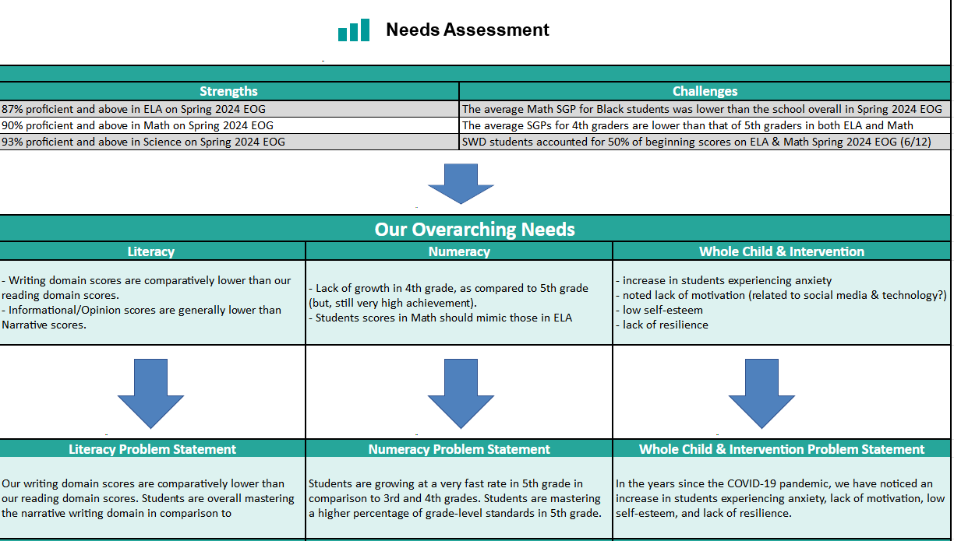
Notes:
Notes for School CIP Teams: After completing your Comprehensive Needs Assessment ( data protocol), you will come here and identify some strengths and opportunities/challenges you have observed from the data. The priority areas are Literacy, Numeracy, and Whole Child & Student Support. Identify an overarching need for each area. Formulate a problem statement for each area. Make sure the problem statement meets the criteria. Refer to your CIP resources.

Slide 7
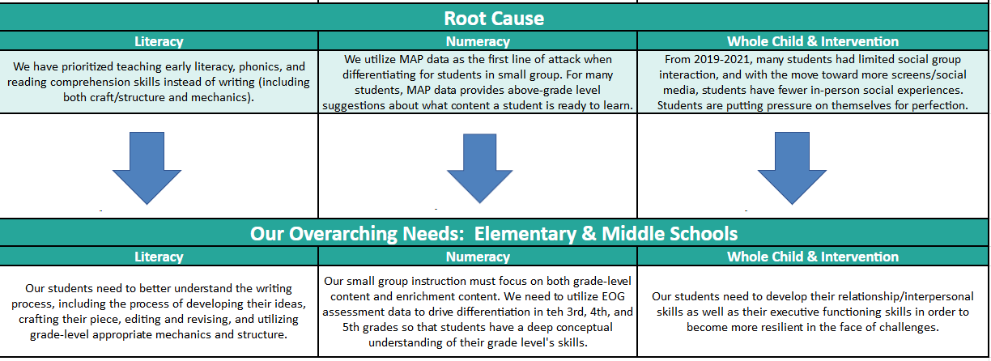
Notes:
Notes for School CIP Teams: After completing your Comprehensive Needs Assessment ( data protocol), you will come here and identify some strengths and opportunities/challenges you have observed from the data. The priority areas are Literacy, Numeracy, and Whole Child & Student Support. Identify an overarching need for each area. Formulate a problem statement for each area. Make sure the problem statement meets the criteria. Refer to your CIP resources.

Slide 8
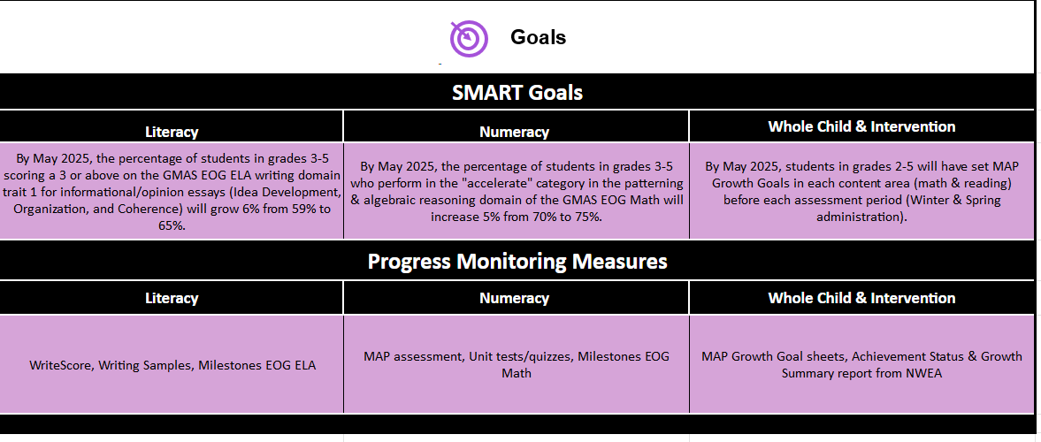

Slide 9
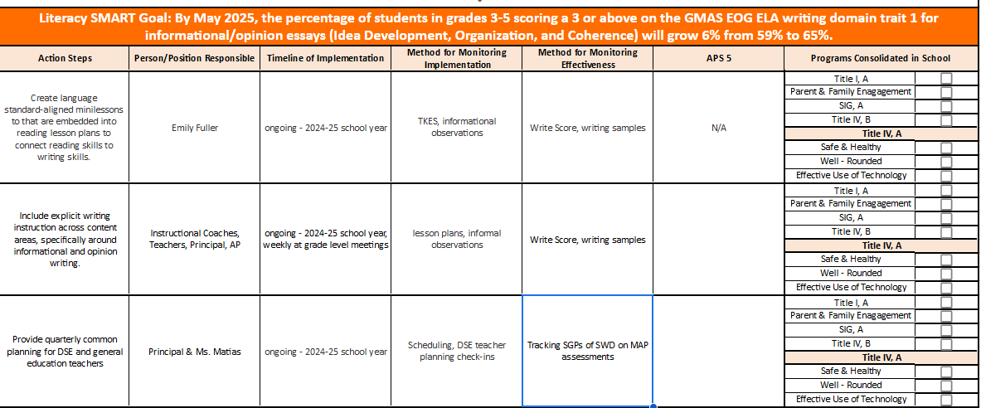

Slide 10
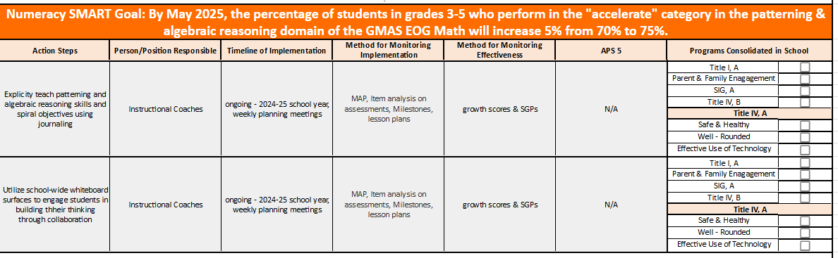

Slide 11
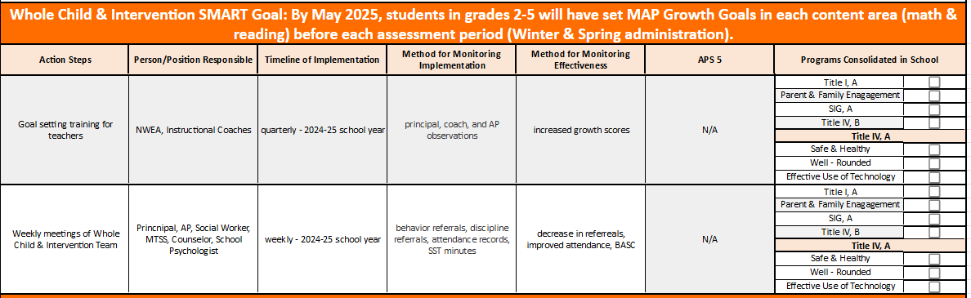

Slide 12
Data Discussion

Slide 13
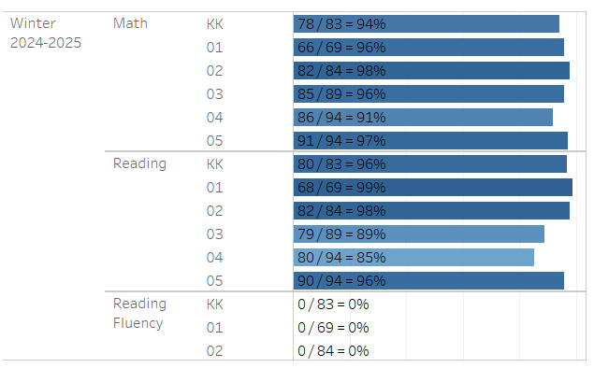
MAP Take Rate – 66.9% (as of 12/10)

Slide 14
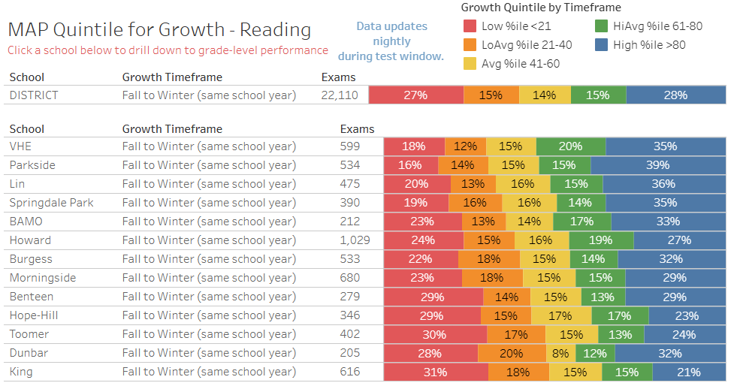
Fall to Winter Growth Quintile
Reading (Grades KK-5) Avg+

Slide 15
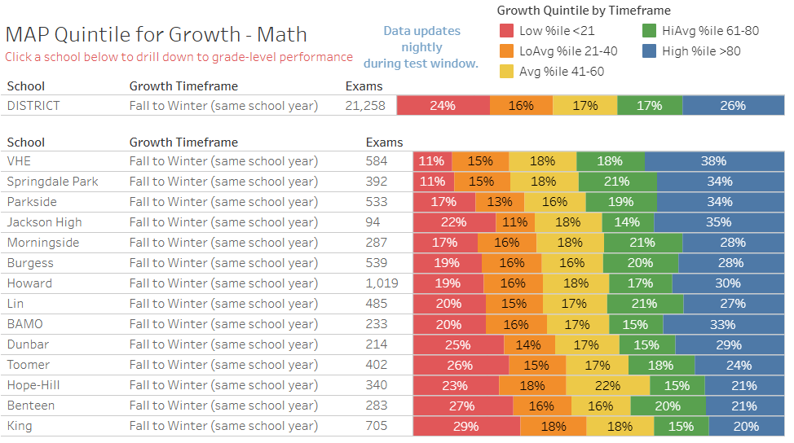
Fall to Winter Growth Quintile
Math (Grades KK-5) Avg+

Slide 16
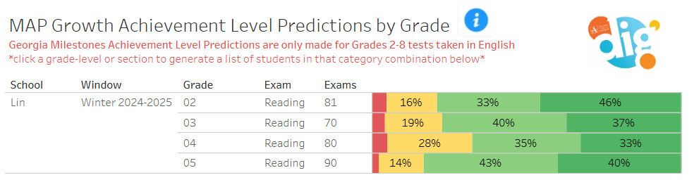
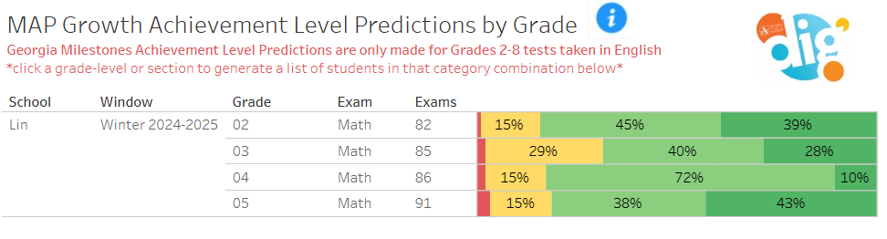
Achievement – Grades 2-5

Slide 17
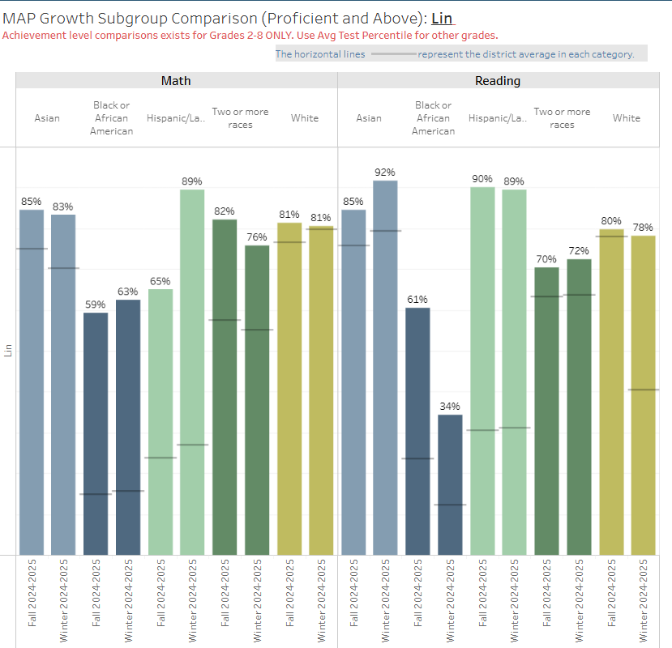
Ethnicity Subgroup Comparison

Slide 18
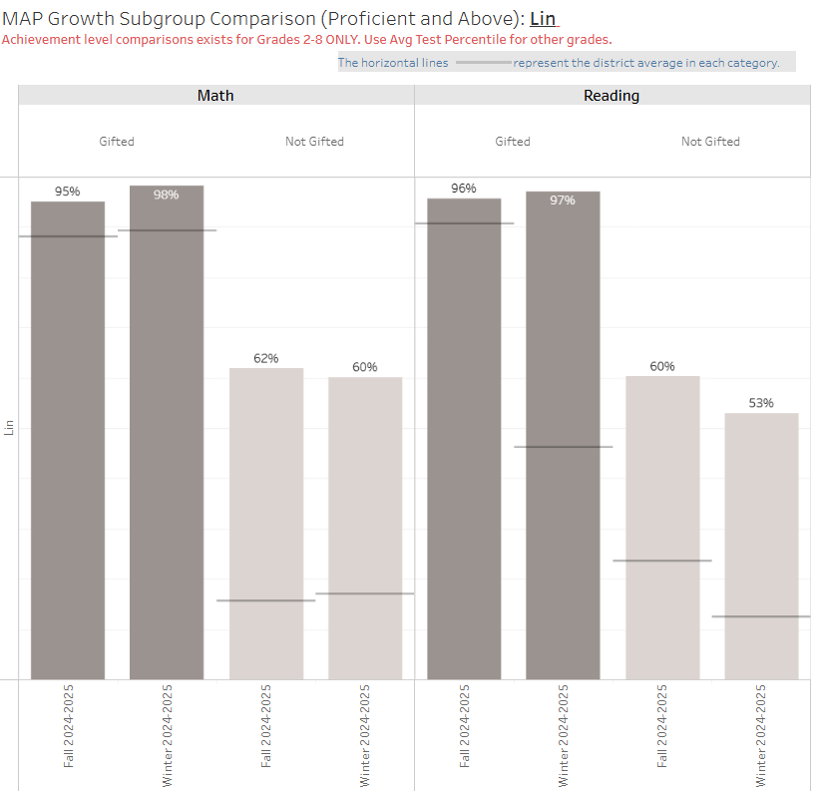
Gifted Subgroup Comparison

Slide 19
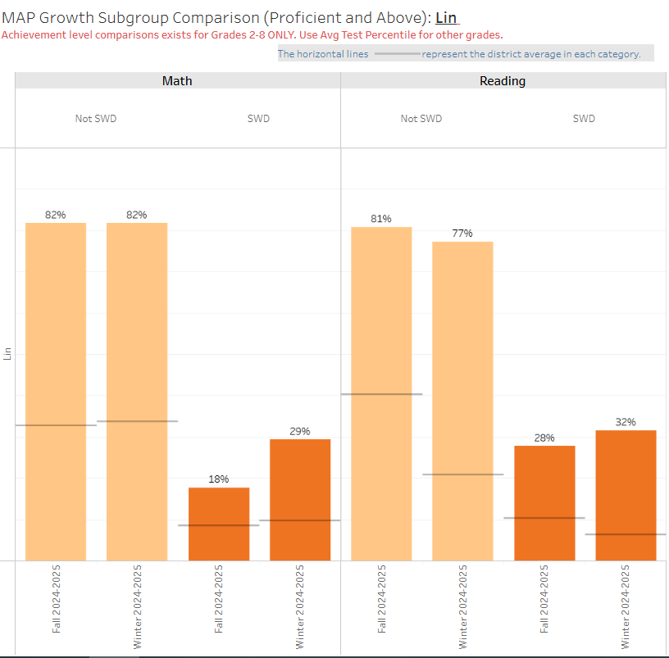
SWD Subgroup Comparison

Slide 20

GO Team Discussion: Data Protocol
What do you notice?
What are your wonderings?
Based on our school’s trend data from MAP assessments and end-of-year test assessments, which student sub-groups and grade levels showed the most significant gaps or unexpected trends?
Based on our school’s trend data from MAP assessments, Milestones and other indicators, are there specific trends that require more focused attention?
What additional questions do you have?

Slide 21
Strategic Plan Progress

Slide 22
Mary Lin Elementary School
Mission: Our vision is to foster students who are lifelong, proactive learners. Our students will be clear communicators who use innovative problem-solving to address the complex issues facing our community and world.
Vision: The mission of Mary Lin Elementary is to educate our students through meaningful, interdisciplinary experiences. Partnerships among students, teachers, and the community will prepare our students to be caring and creative risk-takers ready for the world.
SMART Goals
Percentage of students in grades 3-5 scoring proficient in ELA on GMAS will increase by 1% each year through 2025. Currently, MLE has 89% proficient in ELA.
Percentage of students in grades 3-5 scoring proficient in Math on GMAS will increase by 2% each year through 2025. Currently, MLE has 76% proficient in Math
Show overall growth, as determined by the State of Georgia, for at least 75% of the population in both ELA and Math on GMAS and MAP.
Increase the percentage of students in subgroups who score proficient on GMAS.
APS Strategic Priorities & Initiatives
School Strategic Priorities
School Strategies
Fostering Academic Excellence for All Data
Curriculum & Instruction Signature Program
1. Use data to inform instruction with a focus on both achievement and growth.
2. Adhere to the scope and sequence of the Georgia Standard of Excellence and supplement with STEAM centered resources.
1. Hold monthly data digs led by administration.
2. Weekly lesson planning and internalization led by instructional coaches.
3. PBL units are STEAM focused.
Create collaborative school culture that embraces diverse families that comprise MLE community.
Build teacher capability to meet the diverse social, emotional and academic needs of students.
Provide unique learning opportunities to cultivate students’ curiosity of learning.
Prioritize students’ social and emotional growth as a means of ensuring future success.
Created a new Equity, Diversity, and Inclusion Committee on MLE PTA.
Provide equity and anti-bias training for all staff members.
Engage students in more interdisciplinary and multi-cultural activities both during the school day and after school with a focus on STEAM integration.
Implement small group and individual counseling sessions. Dedicate 15 protected minutes for Morning Meeting and Second Step lessons that focus on social and emotional growth.
Building a Culture of Student Support
Whole Child & Intervention Personalized Learning
Equipping & Empowering Leaders & Staff
Strategic Staff Support Equitable Resource Allocation
Equitably align school resources with MLE mission and vision to become a STEAM certified school.
Implement a plan to improve instructional practices in STEAM.
Choosing STEAM-based and multi-disciplinary curriculum where possible.
Mary Lin Foundation grant approval based on school’s priorities.
Provide resources to teachers to both engage students in STEAM centered opportunities and serve diverse populations.
Provide opportunities for STEM Endorsement training.
Create a committee to review curricular resources amongst staff.
Creating a System of School Support
Strategic Staff Support
Equitable Resource Allocation
Provide an environment that retains, empowers, motivates and inspires teachers to utilize their individual strengths.
Design a learning environment that fosters STEAM-centered education.
System of accountability for school-based leaders.
Leadership and professional learning opportunities for all staff members to meet their needs and interests.
Investing in infrastructure to create flexible learning environments to augment STEAM-centered learning.

Slide 23
2024-2025 (Current)
Strategic Plan
Priority Ranking
Insert the school’s priorities from Higher to Lower
Higher
Equitably align school resources with MLE mission and vision to become a STEAM certified school.
Use data to inform instruction with a focus on both achievement and growth.
Create collaborative school culture that embraces diverse families that comprise MLE community.
Prioritize students’ social and emotional growth as a means to ensuring future success.
Build teacher capability to meet the diverse social, emotional and academic needs of students.
Provide an environment that retains, empowers, motivates and inspires teachers to utilize their individual strengths.
Lower

Slide 24
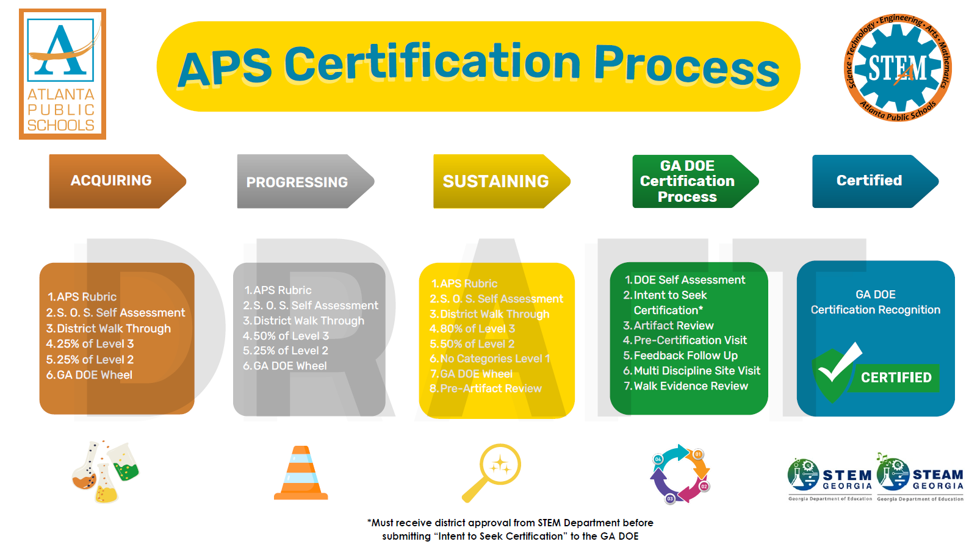

Slide 25
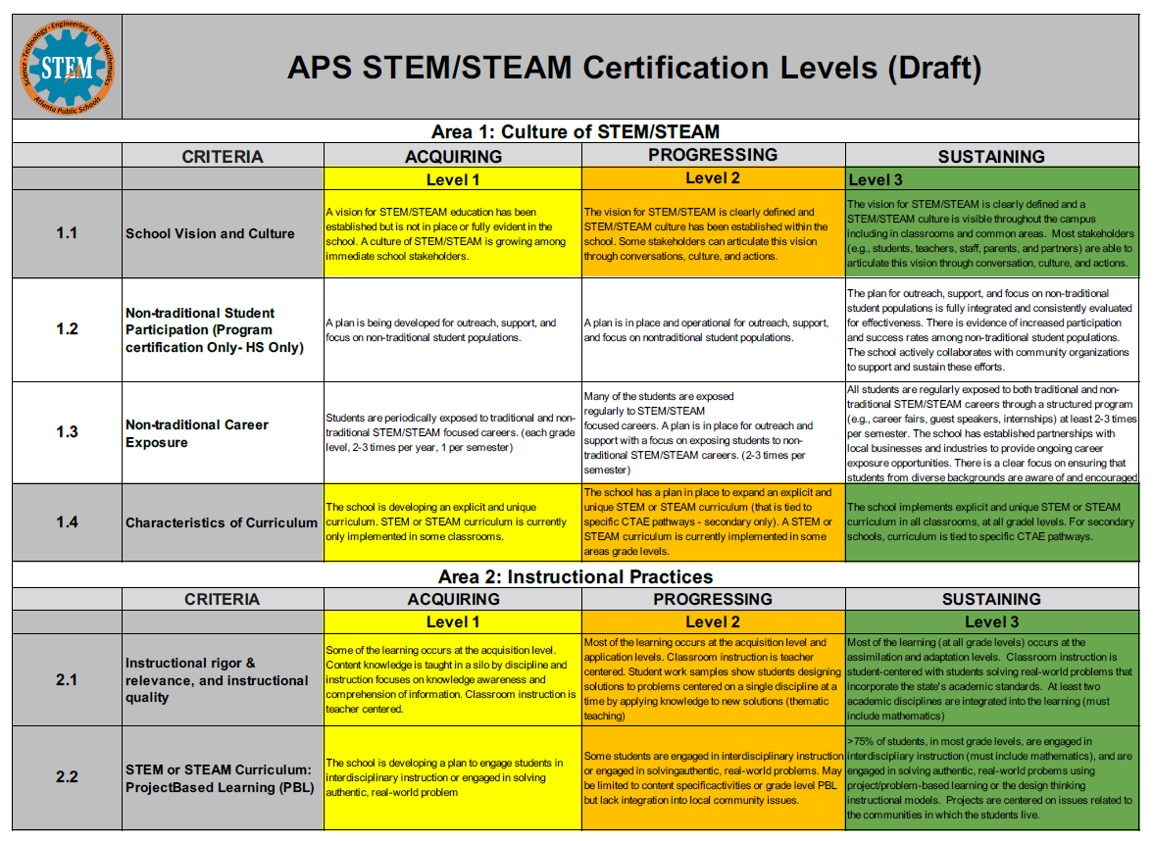

Slide 26
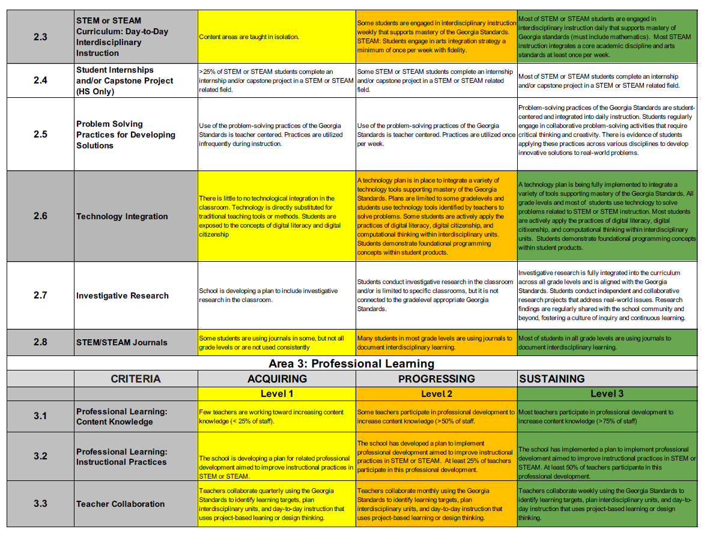

Slide 27
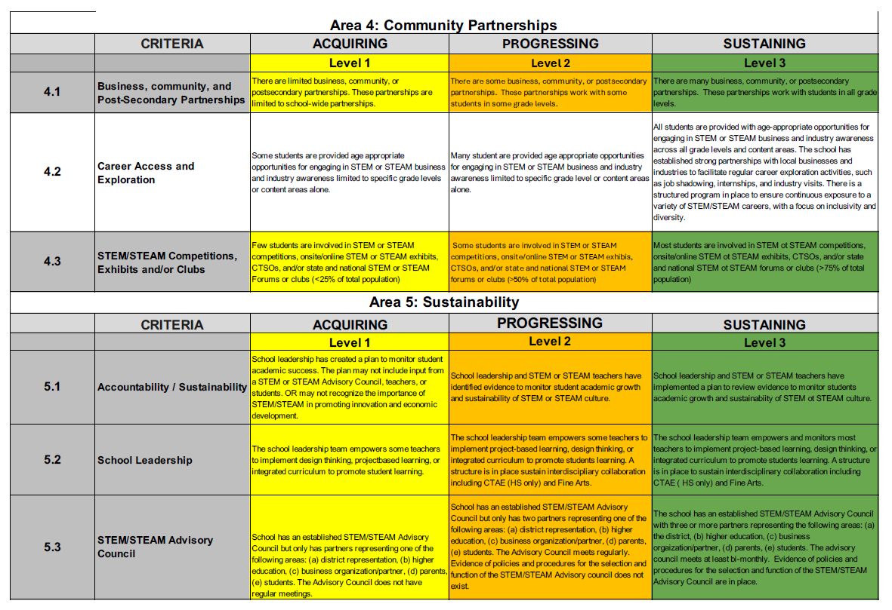

Slide 28
Activity & Discussion
GO TEAM DISCUSSION: Review the priorities and goals in your strategic plan and reflect on if the expected progress is being made. These guiding questions will help you determine what, if any, updates are needed for your school’s strategic plan.
What progress has been made towards the priorities identified in our Strategic Plan? What evidence/data do we have?
Based upon available data, are there any other adjustments we need to make to the Strategic Plan?

Slide 29
Updates to the
Strategic Plan
Enter all changes/updates to your plan – be sure to include accountability measures, as appropriate.

Slide 30
Action on the Updated Strategic Plan
The GO Team needs to TAKE ACTION (vote) on its updated Strategic Plan. After the motion and a second, the GO Team may have additional discussion. Once discussion is concluded, the GO Team will vote.

Slide 31
Preparing for
Budget Development

Slide 32
Discussion
Strategic Plan Priority Ranking
In preparation for the 2025-2026 Budget Development (January–March 2025), the GO Team needs to rank its Strategic Plan Priorities. Use the next slide to capture the priority ranking.

Slide 33
Strategic Plan
Priority Ranking
Insert the school’s priorities from Higher to Lower
Higher
Lower

Slide 34
Action on the
Strategic Plan Priorities
The GO Team needs to TAKE ACTION (vote) on its ranked Strategic Plan Priorities. After the motion and a second, the GO Team may have additional discussion. Once discussion is concluded, the GO Team will vote.

Slide 35
Where we’re going
At our next meeting we will begin the discussion of the 2025-2026 budget.
Let me or the Chair know of any additional information you need for our future discussion.

Slide 36
Principal’s Report

Slide 37
Midtown CAT Report

Slide 38
Thank you

